Slide 1
Molecular biology & basic cellular physiology
Ethics, innovative research, businesses & IPR
Early Lung Cancer and Drug Response Prediction
Guru Jaya Surya Yadav CB.AI.U4AIM24101.
J. Tej Krishna Sai CB.AI.U4AIM24117.
P. Teja Prakash Royal CB.AI.U4AIM24136.
S. Ankith CB.AI.U4AIM24147.

Slide 2
Introduction
Lung cancer is a leading cause of death.
Early detection improves survival.
AI can help detect cancer and suggest the best drugs for treatment.
"Early detection is the key to survival.“
– Dr. Eric Topol

Slide 3
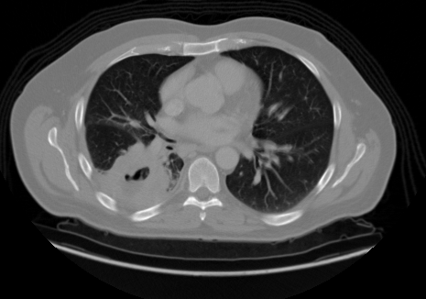
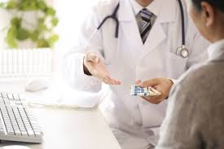
Objectives
Use of CNN model to detect lung cancer from CT scans.
Predict how patients respond to different drugs
Improve cancer treatment using CNN model.

Slide 4
Literature Review
SL.NO | PAPER NAME | SOURCE | METHOD USED | LIMITATIONS
1 | Deep Learning-Based Approach to Diagnose Lung Cancer Using CT-Scan Images | Intelligence-Based Medicine 2024 | Enhanced CNN models (ConvNeXt, VGG16, ResNet50, InceptionV3, EfficientNetB0) for lung cancer classification. | Requires large datasets; potential risk of overfitting; validation needed on diverse populations.
2 | Early Detection of Lung Cancer Using Deep Learning-Based Analysis of CT Scans | IEEE 2023 | Combination of UNET (for segmentation) and LeNet (for classification) on CT scans. | Limited dataset; may not generalize well to real-world medical settings.
3 | A Process Framework for Ethically Deploying Artificial Intelligence in Oncology | Journal of Clinical Oncology | Process-focused ethical framework | Challenges with balancing transparency, privacy, and stakeholder trust in oncology AI

Slide 5
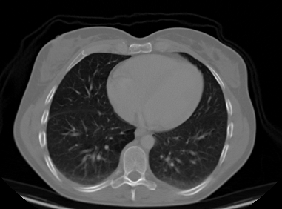
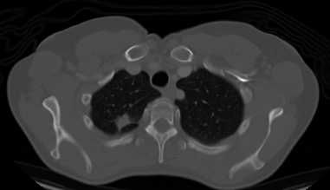
DATASETS
Fig : Adenocarcinoma CT scan
SOURCE OF DATASET:
The Cancer Imaging Archive (TCIA)
Lung Image Database Consortium (LIDC)

Slide 6
Objectives in Computational Aspects
CNN (Deep Learning):Finds lung cancer in CT scans.
SVM (Machine Learning):Predicts which drug works best.
Random Forest:Helps classify patient response to drugs.

Slide 7
Computational Aspects
Models building in CNN
Data Preprocessing:Remove noise, segment images, extract features.
Train AI Model:Use CNN for images
Evaluation:Check accuracy, sensitivity, and precision.
"Artificial intelligence will revolutionize healthcare by making diagnostics faster and more accurate.“
– Fei-Fei Li

Slide 8
Ethical Considerations in Oncology AI
Machine-Based Judgment and Black Box AI
A4R Ethical Framework
Empowerment and Stakeholder Involvement
Data Privacy:Protect patient data (HIPAA, GDPR rules).
Ethics

Slide 9
PATENTS
1.US20230027734A1:System and Method for Predicting the Risk of Future Lung Cancer -2020
2.US20170159137A1: Methods for determining drug response of patient specific mutations. -2015
3.US11447830B2: Predict drug responses for cancer, by analysing tissue samples to determine the presence of altered gene expression associated with drug response. -2019

Slide 10
IPR Rules & Patents
Software & Algorithm Protection : Companies may choose patent
protection for novel AI-driven methodologies or rely on proprietary
data and algorithms as a competitive advantage.
FDA & WHO Approvals:AI in medicine must follow health regulations.
Licensing & Commercialization of AI Models : Companies must license
third-party genetic datasets for research and ensure that data-sharing
policies are complied with.

Slide 11
Project Timeline for Lung Cancer Detection using CNN
Jan 2025, Week 1-2: Define scope & problem statement
Jan 2025, Week 3-4: Collect datasets & assess feasibility
Feb 2025, Week 1: Preprocess CT scan images
Feb 2025, Week 2: Select & implement ML models
Feb 2025, Week 3: Train & optimize models
Feb 2025, Week 4: Validate & refine models
Mar 2025, Week 1: Analyze & compare results
Mar 2025, Week 2: Integrate best model
Mar 2025, Week 3: Prepare documentation
Mar 2025, Week 4: Final submission & presentation

Slide 12
Future Scope
Improve AI model accuracy for early detection.
Use CNN for real-time cancer screening in hospitals.
Connect CNN model with wearable devices for monitoring.

Slide 13
Conclusion
This CNN model can detect lung cancer early and help doctors choose the best treatment.
More data and improvements will make CNN model more accurate.
AI should support, not replace, medical experts.

Slide 14
References
Zhengxiang Jiang, Pengyong Li, DeepDR: a deep learning library for drug response prediction, Bioinformatics, Volume 40, Issue 12, December 2024, btae688
Sangeeta. Pharmacogenomics: Personalized medicine and drug response prediction.Pharma Innovation 2019;8(1):845-848.
Nesbitt, J.C.; Putnam, J.B., Jr.; Walsh, G.L.; Roth, J.A.; Mountain, C.F. Survival in early-stage non-small cell lung cancer. Ann. Thorac. Surg. 1995, 60, 466–472.

Slide 15

Thank You!

